Slide 1

Classes and the need for encapsulation

Slide 2
Outline
In this lesson, we will:
  Discuss the need for restricting access to member variables
  Describe how the compiler helps with overcoming additional costs
  See how making all member variables private prevents future changes to your class from harming your existing user base
  Define the idea of an interface to a class

Slide 3
Review of encapsulation
Let us look at the Vector_3d class
  It has three member variables: x_, y_ and z_
Why not leave them public and just call them x, y and z?
  class Vector_3d {
  public:
  double x;
  double y;
  double z;
  };
After all, this would be easier and simpler, as there are absolutely no restrictions on their values
  Nothing the user sets any of these to will affect the object

Slide 4
Using member functions
For example, why waste the time to do the following?
  class Vector_3d {
  public:
  Vector_3d{ double new_x = 0.0,
  double new_y = 0.0,
  double new_z = 0.0 };
  double x();
  double y();
  double z();
  void x( double new_x );
  void y( double new_y );
  void z( double new_z );
  private:
  double x_;
  double y_;
  double z_;
  };

Slide 5
Using member functions
One problem is, you are not clairvoyant,
you cannot predict the future
Once users are accessing your member variables,
you can no longer change your underlying design of the class
Suppose we do it the “hard” way:
  Every time the user wants a member variable,
  the user must call the appropriate member function
  However, that’s not true:
    The compiler can decide to inline very short function calls
    That is, the compiler will replace the function call with code that achieves what the function call would have done

Slide 6
Our implementation
class Vector_3d {
public:
Vector_3d( double new_x = 0.0,
double new_y = 0.0,
double new_z = 0.0 );
double x() const;
double y() const;
double z() const;
void x( double new_x );
void y( double new_y );
void z( double new_z );
private:
double x_;
double y_;
double z_;
};
Vector_3d::Vector_3d( double new_x,
double new_y, double new_z ) {
x_{ new_x },
y_{ new_y },
z_{ new_z } {
// Empty constructor
}
s
double Vector_3d::x() const {
return x_;
}
double Vector_3d::y() const {
return y_;
}
double Vector_3d::z() const {
return z_;
}
void Vector_3d::x( double new_x ) const {
x_ = new_x;
}
void Vector_3d::y( double new_y ) const {
y_ = new_y;
}
void Vector_3d::z( double new_z ) const {
z_ = new_z;
}

Slide 7
Using member functions
Suppose after using this class for a few months,
you determine it is better to use an array
instead of three separate member variables
  If your users were all using the public member variables,
  your change would break all their code!
  This does not make any users happy!
However, if you changed the underlying representation to an array and all users were always calling the member functions anyway…
  You just have to change how the member functions work

Slide 8
Our implementation
class Vector_3d {
public:
Vector_3d( double new_x = 0.0,
double new_y = 0.0,
double new_z = 0.0 );
double x() const;
double y() const;
double z() const;
void x( double new_x );
void y( double new_y );
void z( double new_z );
private:
double xyz_[3];
};
Vector_3d::Vector_3d( double new_x,
double new_y, double new_z ) {
xyz_{ new_x, new_y, new_z } {
// Empty constructor
}
s
double Vector_3d::x() const {
return xyz_[0];
}
double Vector_3d::y() const {
return xyz_[1];
}
double Vector_3d::z() const {
return xyz_[2];
}
void Vector_3d::x( double new_x ) const {
xyz_[0] = new_x;
}
void Vector_3d::y( double new_y ) const {
xyz_[1] = new_y;
}
void Vector_3d::z( double new_z ) const {
xyz_[2] = new_z;
}

Slide 9
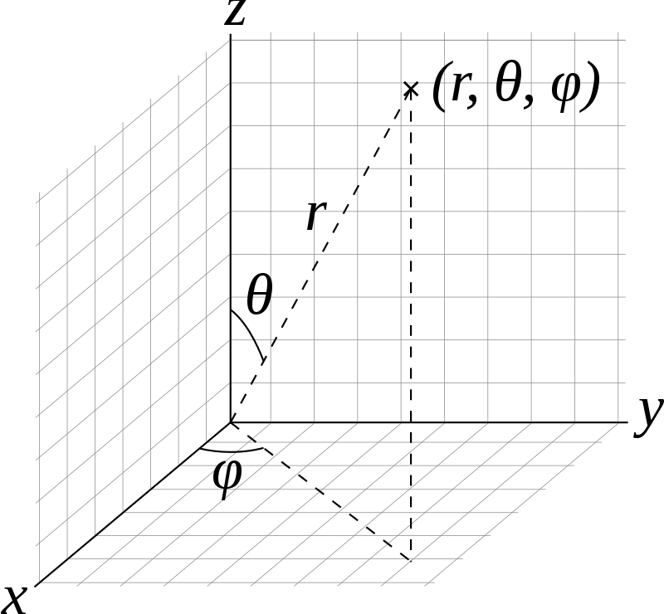
Private member variables
However, suppose you also implement the following member functions to return the spherical coordinates:
Wikipedia user: Andeggs

Slide 10
Our implementation
class Vector_3d {
public:
Vector_3d( double new_x = 0.0,
double new_y = 0.0,
double new_z = 0.0 );
double x() const;
double y() const;
double z() const;
double r() const;
double theta() const;
double phi() const;
void x( double new_x );
void y( double new_y );
void z( double new_z );
void r( double new_r );
void theta( double new_theta );
void phi( double new_phi );
private:
double x_;
double y_;
double z_;
void to_rect( double r, double theta, double phi );
};

Slide 11
Our implementation
double Vector_3d::r() const {
return std::sqrt( x()*x() + y()*y() + z()*z() );
}
double Vector_3d::theta() const {
return std::acos( z()/r() );
}
double Vector_3d::phi() const {
return std::atan2( y(), x() );
}
void Vector_3d::to_rect( double r, double theta, double phi ) {
x_ = r*std::sin( theta )*std::cos( phi );
y_ = r*std::sin( theta )*std::sin( phi );
z_ = r*std::cos( theta );
}

Slide 12
Our implementation
void Vector_3d::r( double new_r ) const {
to_rect( new_r, theta(), phi() );
}
void Vector_3d::theta( double new_theta ) const {
to_rect( r(), new_theta, phi() );
}
void Vector_3d::phi( double new_phi ) const {
to_rect( r(), theta(), new_phi );
}

Slide 13
Private member variables
Now, your 3-dimensional vector class is being used;
however, more and more calculations simply require the spherical coordinates and not the rectangular coordinates
If the member variables were public, there is nothing you could do…
  However, if they’re private, just change them and
  rewrite the corresponding member functions
    From a compilation point-of-view,
    no one will note the difference

Slide 14
Our implementation
class Vector_3d {
public:
Vector_3d( double new_x = 0.0,
double new_y = 0.0,
double new_z = 0.0 );
double x() const;
double y() const;
double z() const;
double r() const;
double theta() const;
double phi() const;
void x( double new_x );
void y( double new_y );
void z( double new_z );
void r( double new_r );
void theta( double new_theta );
void phi( double new_phi );
private:
double r_;
double theta_;
double phi_;
void to_spherical( double x, double y, double z );
};

Slide 15
Our implementation
Vector_3d::Vector_3d( double x, double y, double z ) {
r_{ std::sqrt( x*x + y*y + z*z ) },
theta_{ std::acos( z/r_ ) },
phi_{ std::atan2( y, x ) } {
// Empty constructor
}
double Vector_3d::x() const {
return r_*std::sin( theta_ )*std::cos( phi_ );
}
double Vector_3d::y() const {
return r_*std::sin( theta_ )*std::sin( phi_ );
}
double Vector_3d::z() const {
return r_*std::cos( theta_ );
}

Slide 16
Our implementation
void Vector_3d::x( double new_x ) const {
to_spherical( new_x, y(), z() );
}
void Vector_3d::y( double new_y ) const {
to_spherical( x(), new_y, z() );
}
void Vector_3d::z( double new_z ) const {
to_spherical( x(), y(), new_z );
}

Slide 17
Our implementation
double Vector_3d::r() const {
return r_;
}
double Vector_3d::theta() const {
return theta_;
}
double Vector_3d::phi() const {
return phi_;
}

Slide 18
Our implementation
void Vector_3d::r( double new_r ) const {
if ( new_r < 0.0 ) {
throw std::domain_error{ "The radius cannot be negative, but got “
+ std::to_string( new_r ) };
}
r_ = new_r;
}
void Vector_3d::theta( double new_theta ) const {
if ( (new_theta < 0.0) || (new_theta > M_PI) ) {
throw std::domain_error{ "The inclination must be in [0, pi], but got "
+ std::to_string( new_theta ) };
}
theta_ = new_theta;
}
void Vector_3d::phi( double new_phi ) const {
if ( (new_phi < 0.0) || (new_phi >= 2.0*M_PI) ) {
throw std::domain_error{ "The azimuth must be in [0, 2 pi), but got "
+ std::to_string( new_phi ) };
}
phi_ = new_phi;
}

Slide 19
Member functions and interfaces
Now, the scenario presented is not likely,
but it should make you recognize the usefulness of restricting
access to member variables, even if initially it seems unnecessary
Also, if a function is very short, the compiler may simply decide to inline the function, meaning, replace the function call with equivalent code in place of the function call
  Thus, there is no effect on run time what-so-ever
Another term for the collection of all member functions that allow the user to access and manipulate an instance of a class is the interface for that class

Slide 20
Summary
Following this lesson, you now
  Understand the need for encapsulation
  Know that the compiler will help ameliorate the potential impact of having member function calls through inlining
  Know that another term for all member functions that allow you to access a class is the interface

Slide 21
References
[1] https://en.wikipedia.org/wiki/C++_classes
[2] https://en.wikipedia.org/wiki/Inline_expansion
[3] https://en.wikipedia.org/wiki/Spherical_coordinate_system
[4] https://en.wikipedia.org/wiki/Interface_(computing)

Slide 22



Colophon
These slides were prepared using the Georgia typeface. Mathematical equations use Times New Roman, and source code is presented using Consolas.
The photographs of lilacs in bloom appearing on the title slide and accenting the top of each other slide were taken at the Royal Botanical Gardens on May 27, 2018 by Douglas Wilhelm Harder. Please see
https://www.rbg.ca/
for more information.

Slide 23
Disclaimer
These slides are provided for the ece 150 Fundamentals of Programming course taught at the University of Waterloo. The material in it reflects the authors’ best judgment in light of the information available to them at the time of preparation. Any reliance on these course slides by any party for any other purpose are the responsibility of such parties. The authors accept no responsibility for damages, if any, suffered by any party as a result of decisions made or actions based on these course slides for any other purpose than that for which it was intended.

